Slide 1

Databases & SQL for Data Science with Python
PROFESSIONAL CERTIFICATE IBM Data Analyst

Slide 2
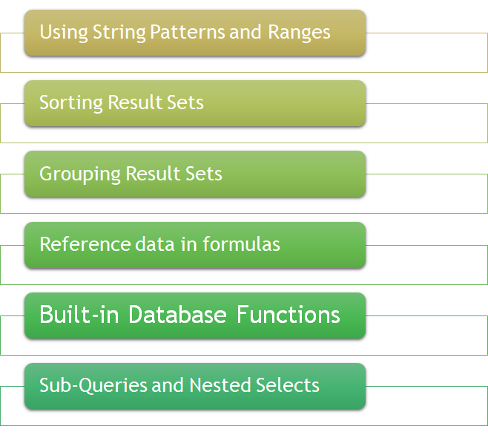
In this week!

Slide 3
SELECT Statement Review
select * from <table name> ;
SELECT column1, column2, ... FROM table_name;
SELECT column1, column2, ... FROM table_name WHERE condition;
Notes:
SELECT CustomerName, City FROM Customers;
SELECT * FROM Customers WHERE Country='Mexico';

Slide 4
WHERE Clause
The WHERE clause always requires a predicate, which is a condition that evaluates to true, false or unknown
But what if we don't know exactly what value the predicate is?
”Answer is in the next slide”

Slide 5
String pattern: LIKE Operator
The like predicate is used in a WHERE clause to search for a pattern in a column.
SELECT column1, column2, ... FROM table_name WHERE columnN LIKE pattern;

Slide 6
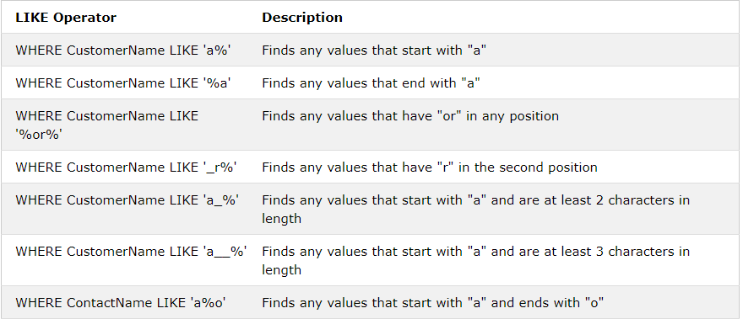
LIKE operators with '%' and '_' wildcards
The percent sign is used to define missing letters.
The percent sign is called
a wildcard character
https://www.w3schools.com/sql/sql_like.asp

Slide 7
Exercise
Write SQL statement that retrieves all students with a StudentName starting with “T“, form University table.

Slide 8
Exercise
Write SQL statement that retrieves all students with a StudentName starting with “T“, form University table.
SELECT * FROM University WHERE StudentName LIKE ’T%';

Slide 9
Between Operator
SELECT column_name(s) FROM table_name WHERE column_name BETWEEN value1 AND value2;

Slide 10
Exercise
Write SQL statement that selects all Participants from NPower table, with a score BETWEEN 60 and 90.

Slide 11
Exercise
Write SQL statement that selects all Participants from NPower table, with a score BETWEEN 60 and 90.
SELECT * FROM NPower WHERE score BETWEEN 60 AND 90;

Slide 12
Exercise
Write SQL statement that selects all Participants from Participants table, with a score BETWEEN 60 and 90. [use where clause]
SELECT * FROM Participants WHERE score>= 60 AND score <=90;

Slide 13
IN Operator
SELECT column_name(s) FROM table_name WHERE column_name IN (value1, value2, ...);

Slide 14
Exercise
Select all Participants from NPower table who are located in “Calgary, GTA, Halifax”

Slide 15
Exercise
Select all Participants from NPower table who are located in “Calgary, GTA, Halifax”
SELECT * FROM Npower WHERE Location IN (' Calgary ', ' GTA ', ' Halifax ');

Slide 16
Exercise
Select all Participants from Participants table who are located in “Calgary, GTA, Halifax” [don’t use IN]
SELECT * FROM Participants WHERE Location=‘Calgary’ OR Location=‘GTA’ OR Location=‘Halifax’;

Slide 17
Sorting Result Sets
How to display the result in alphabetical order?
How to display the result in descending order?
How to display the result in descending order for a specific column?

Slide 18
Sorting Result Sets
How to display the result in alphabetical order?
Select title from Book ORDER BY title
How to display the result in descending order?
Select title from Book Order BY title DESC
How to display the result in descending order for a specific column?
Select title from Book Order BY 2 DESC

Slide 19
Built-in Database Functions
List some aggregate or column function, what do they do?
List some Scalar and String functions, what do they do?
List some built-in BD2 functions for date and time?
Notes:
sum, minimum, maximum, average, etc.
Round(), Length, Ucase, LCASE
Day(),
Month(), day of month(),
day of week(), day of year(),
Week(), hour(), minute(), and second().

Slide 20
Grouping Result Sets
Eliminate duplicates from a result set
Describe how to further restrict a result set

Slide 21
Exercise
What is the output from the following query?
SELECT Country, COUNT(CustomerID) as Count FROM Customers GROUP BY Country;

Slide 22
Exercise
What is the output from the following query?
SELECT Country, COUNT(CustomerID) as Count FROM Customers GROUP BY Country;
Countries are grouped and then counted using the count function.

Slide 23
Hands-on Lab
Take 30 minutes to complete the hands-on Lab : String Patterns, Sorting & Grouping

Slide 24
Exercise: True or False
True or False
•Aggregate functions can be used in the WHERE clause without a select statement
Notes:
False

Slide 25
Sub-Queries and Nested Selects
•What is meant by sub_queries?
•When should we use sub_queries?

Slide 26
Exercise
What should be the output of the following SQL statement?
Select EMP_ID, SALARY, AVG(SALARY) AS AVG_SALARY from employees
Notes:
Running this query will result in an error indicating that no group by clause is specified.

Slide 27
Correct statement without Group By
select EMP_ID, SALARY, (select AVG(SALARY) from employees) AS AVG_SALARY from employees

Slide 28
Breakout Room Activity
Take 40 minutes to complete week 3 activity posted on Blackboard

Slide 29
Any questions

